Slide 1
Advanced Algorithms
Weiwei Wu

Slide 2
Project open:
    http://app.yinxiang.com/l/AAG21_3CBs1MAIDshfmXg3n__PI_l1tRbTg/
    http://app.yinxiang.com/l/AAEWNcadtzVNeZud3nrBipJyXeAERd5uQ6Q/

Slide 3
Outline
Greedy analysis
This week
  Greedy coverage
    Max k-cover
    Budgeted max coverage

Slide 4
Max k-cover
Problem
  N sets with covered area
  Choose L sets
  Max the total covered area or area with weights
Key to learn:
  how to analyze a greedy rule
  vs knapsack
  vs set cover

Slide 5
Max k-cover
Problem
  N sets with covered area
  Choose L sets
  Max the total covered area or area with weights
Key to learn:
  how to analyze a greedy rule
  vs knapsack
  vs set cover

Slide 6
Max k-cover
Problem
  N sets with covered area
  Choose L sets
  Max the total covered area or area with weights
Key to learn:
  how to analyze a greedy rule
    Each round
        Greedy with max (current) value
        Until the total number k is used up

Slide 7
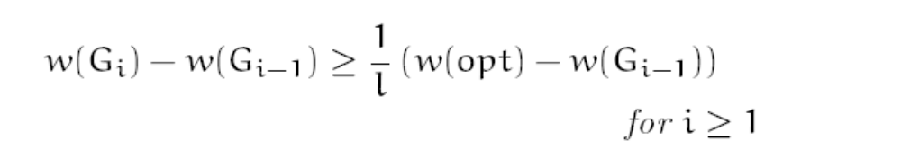
Max k-cover
Analysis
  Let S_i be the set chosen in iteration i
  Let G_i be the set chosen before iteration i
  Lemma:
    Q: why?

Slide 8

Max k-cover
Analysis
  Let S_i be the set chosen in iteration i
  Let G_i be the set chosen before iteration i
  Lemma:
    Q: why?
    G_i-G_{i-1}>=1/(L)*(…)
    Q: what property with induction?

Slide 9
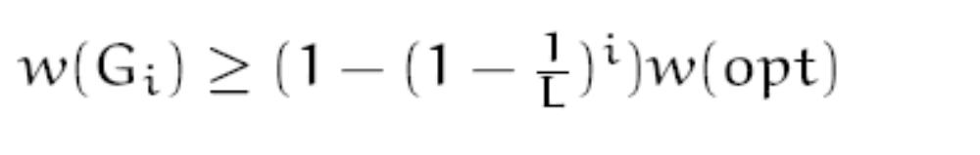
Max k-cover
Analysis
  Let S_i be the set chosen in iteration i
  Let G_i be the set chosen before iteration I
  Lemma:
    Why?

Slide 10
Max k-cover
Analysis
  M1: induction Q: how?
    i=1: w(G_1)>=1/L * OPT

Slide 11
Max k-cover
Analysis
  M1: induction
    i=1: w(G_1)>=1/L * OPT
    Hypothesis:
    Suppose hold with i-1, then ?

Slide 12
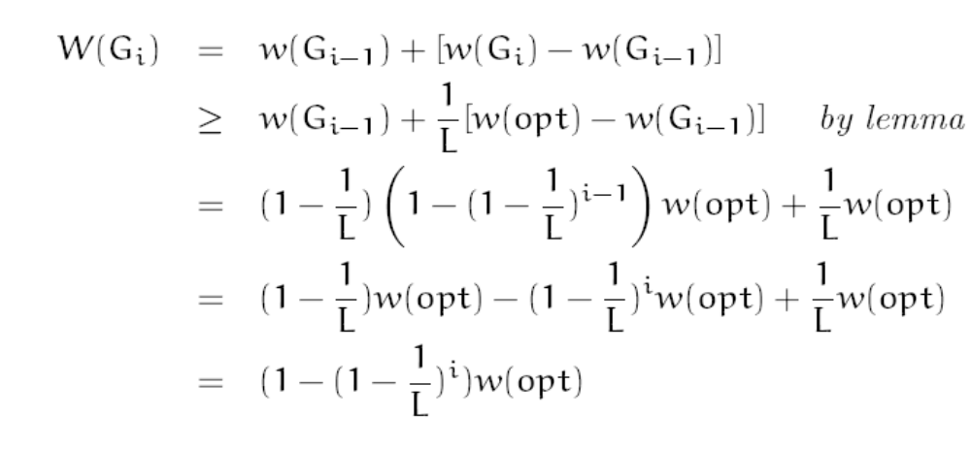
Max k-cover
Analysis
  M1: induction
    i=1: w(G_1)>=1/L * OPT
    Hypothesis:
    Suppose hold with i-1, then
    Relation with OPT?

Slide 13

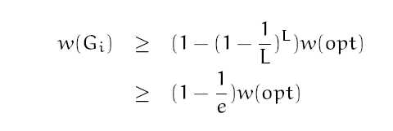
Max k-cover
Analysis
  M1: induction
    i=1: w(G_1)>=1/L * OPT
    Hypothesis:
    Suppose hold with i-1, then

Slide 14
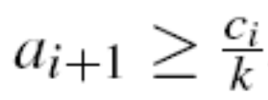
Max k-cover
Analysis
  M2:
    Let a_i be the set chosen in iteration i
    Let G_i be the set chosen by iteration I
    c_i=OPT-G_i
    Lemma:
    Q: why?

Slide 15
Max k-cover
Analysis
  M2:
    Let a_i be the set chosen in iteration i
    Let G_i be the set chosen by iteration I
    c_i=OPT-G_i
    Lemma:
    Q: why?

Slide 16

Max k-cover
Analysis
  M2:
    Let a_i be the set chosen in iteration i
    Let G_i be the set chosen by iteration I
    c_i=OPT-G_i
    Lemma:
    Q: why?

Slide 17
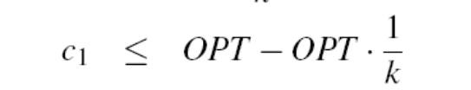
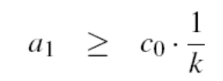
Max k-cover
Analysis
  M2: induction Q: how?
    i=1:

Slide 18
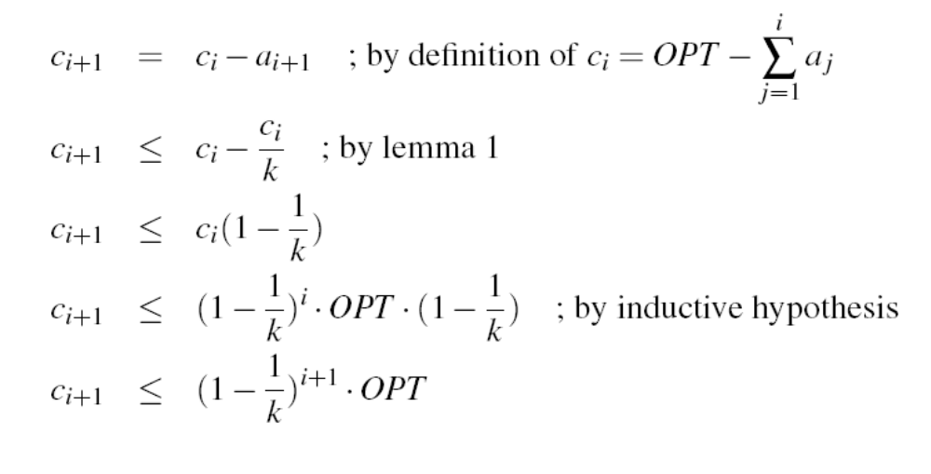

Max k-cover
Analysis
  M1: induction
    i=1:
    Hypothesis:
    Suppose hold with i-1, then ?

Slide 19
Max budget-cover
Problem
  N sets
  each with covered area w_i and cost c_i
  Choose sets with budget L
  Max the total covered area or area with weights
Key to learn:
  how to analyze a greedy rule
  How to generalize?

Slide 20
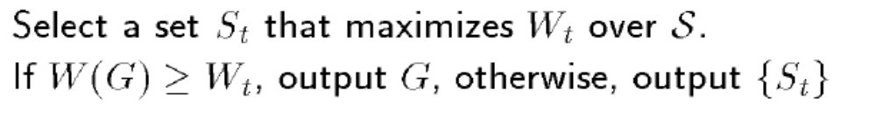
Max budget-cover
Problem
  N sets
  each with covered area w_i and cost c_i
  Choose sets with budget L
  Max the total covered area or area with weights
ALG?
    W(G)=Greedy in max (G_i-G_{i-1})/c_i

Slide 21

Max budget-cover
Analysis
  P1: property extend
    w_i’ largest,
    all other i’’<=w_i’/c_i per cost
    L, per cost
    In total w(OPT\G_{i-1})<=(L/c_i)w_i’ at most

Slide 22

Max budget-cover
Analysis
  M1: induction Q: how?
    i=1:

Slide 23

Max budget-cover
Analysis
  M1: induction
    i=1:
    Hypothesis: G_{i-1}>=
    Suppose hold with i-1, then ?

Slide 24
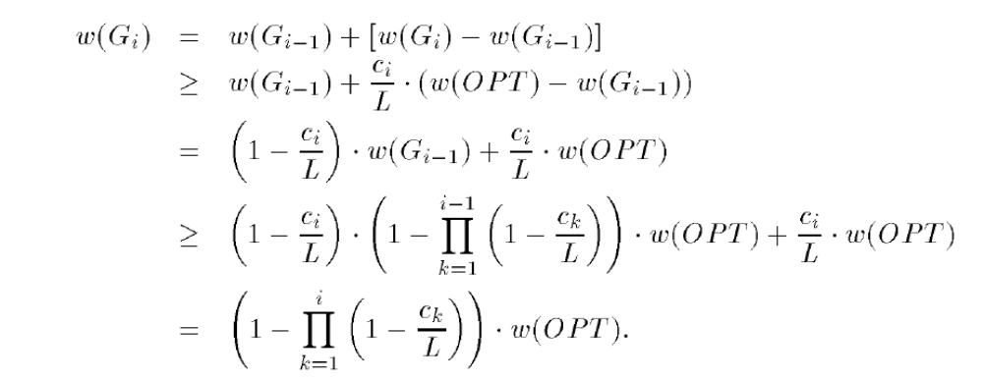
Max budget-cover
Analysis
  M1: induction
    i=1:
    Hypothesis:
    Suppose hold with i-1, then
    Relation with OPT?

Slide 25
Max budget-cover
Analysis
  M1: induction
    i=1:
    Hypothesis:
    Suppose hold with i-1, then
    Relation with OPT?

Slide 26

Max budget-cover
Analysis
  M1: induction
    Relation with OPT?

Slide 27
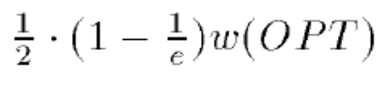
Max budget-cover
Analysis
  M1: induction
    Relation with OPT?

Slide 28

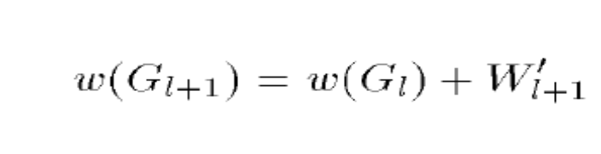

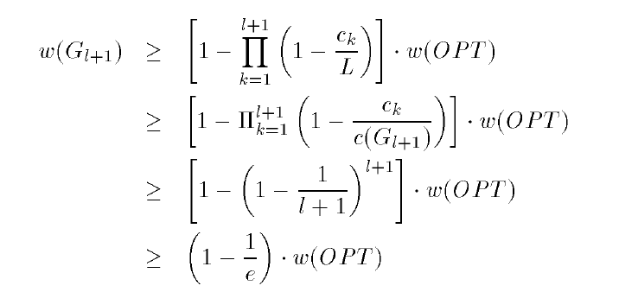
Max budget-cover
Analysis
  M1: induction
    Relation with OPT?
      be the first exceeding L
because c(G_{l+1})>L
because LB at c_k=1/(l+1)c(G_{l+1})

Slide 29
Max budget-cover
Analysis
  M1: induction
    Relation with OPT?
      G_{l+1} be the first exceed L
because c(G_{l+1})>L
because LB at c_k=1/(l+1)c(G_{l+1})

Slide 30

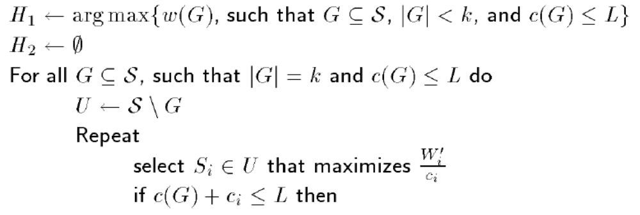
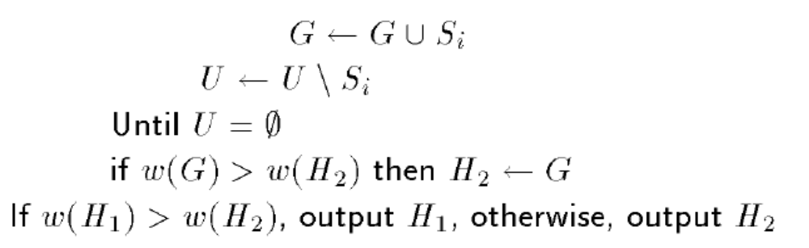
Max budget-cover
Improving:
  ALG?

Slide 31






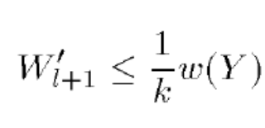
Max budget-cover
Analysis
    Set k>=3?
      |OPT|<=k
      |OPT|>k?
because c(G_{l+1})>c(OPT\Y)

Slide 32
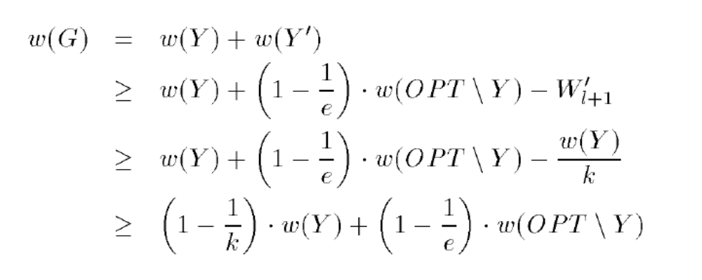
Max budget-cover
Analysis
    Set k>=3?
      |OPT|<=k
      |OPT|>k?

Slide 33
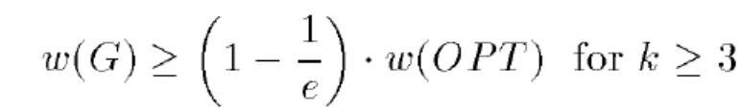
Max budget-cover
Analysis
    Set k>=3?
      |OPT|<=k
      |OPT|>k?

Slide 34
Extension
Any idea for better solution for knapsack?
    Similar idea for first k sets
    Another choosing:

Slide 35
Extension
Any idea for better solution for knapsack?
    Similar idea for first k sets
    Another choosing:
      By sorting the items with decreasing value
      Selecting possible large values
      Pending more small values

Slide 36
Extension
Any idea for better solution for knapsack?
    Similar idea for first k sets
    Another choosing:
      By sorting the items with decreasing value
      Selecting possible large values
      Pending more small values
      If |OPT|<=k →find it
      If |OPT|>k pending more small values
      Enumerating possible <=k solutions + enumerating first k largest values + greedy
      APPROXI?

Slide 37
Extension
Any idea for better solution for knapsack?
    Similar idea for first k sets
    Another choosing:
      By sorting the items with decreasing value
      Selecting possible large values
      Pending more small values
      If |OPT|<=k →find it
      If |OPT|>k pending more small values
      Enumerating possible <=k solutions + enumerating first k largest values + greedy
      APPROXI:
      If |OPT|<=k →ALG=OPT
      If |OPT|>k → ALG=Y+Greedy(G_l)
      Y+Greedy(G_l)+M_{l+1}>=OPT
      M_{l+1}<=OPT
      ALG=Y+Greedy(G_l)>=OPT-M_{l+1}
      >= (1-1/k)OPT

Slide 38
Thank U!

Slide 39
Optimality through dynamic programming
---how does DP work
Problem: interval scheduling
  1 machine/or classroom
  n classes: each with start time r_i, deadline d_i
  Pack the classes over one day
  unweigted/weighted
  Obj: max the number/value
  Application
Unweighted:
  What if earliest arrvial?
  What if shortest first? Counter example
Q: dynamic programming solution
  See also: 2nd_lecture.pdf
    Q: optimality?
    Thinking: multiple machines?

Slide 40
Optimality through dynamic programming
--how to design DP for your problem
Problem: knapsack
  1 bag with size C
  n items: each with size c_i, value v_i
  Pack the items with total size at most C
  Obj: max the value
  Application: memory, register, space, VM…
Q: dynamic programming solution

Slide 41
Optimality through dynamic programming
Problem: knapsack
  1 bag with size C
  n items: each with size c_i, value v_i
  Pack the items with total size at most C
  Obj: max the value
Q: dynamic programming solution
  Q1: what does the function look like?
  Q2: what is the subproblem in high level?

Slide 42
Optimality through dynamic programming
Problem: knapsack
  1 bag with size C
  n items: each with size c_i, value v_i
  Pack the items with total size at most C
  Obj: max the value
Q: dynamic programming solution
  Q1: what does the function look like?
  Q2: what is the subproblem in high level?
  Q3: the function? Think about the last item to add
  Q4: loop over which variant
  Q5: the function?
      Knapsack(i，c)=max{ knapsack(i-1,c), knapsack(i-1, c-c_i)+v_i}

Slide 43
Optimality through dynamic programming
Problem: knapsack
  1 bag with size C
  n items: each with size c_i, value v_i
  Pack the items with total size at most C
  Obj: max the value
Q: dynamic programming solution
  Q1: what does the function look like?
  Q2: what is the subproblem in high level?
  Q3: the function? Think about the last item to add
  Q4: loop over which variant
  Q5: the function?
      Knapsack(i，c)=max{ knapsack(i-1,c), knapsack(i-1, c-c_i)+v_i}
  Q6: what if the index i is removed?
    Reduce ?
  Q7: think about the order? Order matters?

Slide 44
Optimality through dynamic programming
Problem: knapsack
  1 bag with size C
  n items: each with size c_i, value v_i
  Pack the items with total size at most C
  Obj: max the value
Q: dynamic programming solution
  Q1: what does the function look like?
  Q2: what is the subproblem in high level?
  Q3: the function? Think about the last item to add
  Q4: loop over which variant
  Q5: the function?
      Knapsack(i，c)=max{ knapsack(i-1,c), knapsack(i-1, c-c_i)+v_i}
  Q6: what if the index i is removed?
    Reduce ? space but not time
  Q7: think about the order? Order matters?

Slide 45
Optimality through dynamic programming
Problem: knapsack
  1 bag with size C
  n items: each with size c_i, value v_i
  Pack the items with total size at most C
  Obj: max the value
Q: dynamic programming solution
  Q1: what does the function look like?
  Q2: what is the subproblem in high level?
  Q3: the function? Think about the last item to add
  Q4: loop over which variant
  Q5: the function?
  Q6: what if the index i is removed?
  Q7: think about the order? Order matters?
  Q8: what is the role of the index i? exponential vs poly
  Q9: can we remove the index i? run an instance

Slide 46
Optimality through dynamic programming
Problem: knapsack
  1 bag with size C
  n items: each with size c_i, value v_i
  Pack the items with total size at most C
  Obj: max the value
Q: dynamic programming solution
  Optimality? Bottom-up, tree-structure tracking to max/exist path,
  Last Q: do you find how this problem ‘was’ solved?
  DC vs. DP?

Slide 47
Optimality through dynamic programming
Problem: knapsack
  1 bag with size C
  n items: each with size c_i, value v_i
  Pack the items with total size at most C
  Obj: max the value
Q: dynamic programming solution
  Optimality? Bottom-up, tree-structure tracking to max/exist path,
  Last Q: do you find how this problem ‘was’ solved?
  DC vs. DP?
  reuse, bottom up, mergsort

Slide 48
Optimality through dynamic programming
Problem from research:
min active time for data center
  1 machine with state active/idle
  n tasks: each task j with
    Processing time p_j
    Release time r_i
    Deadline d_i
  Allocate the tasks with intersection
  Obj: min total active value
Q: what is the dynamic programming solution
  open for you: how to reduce from exponential to polynomial
Tips: is there another DP for the weighted interval scheduling?

Slide 49
Optimality through dynamic programming
Problem from research:
min active time for data center
  1 machine with state active/idle
  n tasks: each task j with
    Processing time p_j
    Release time r_i
    Deadline d_i
  Allocate the tasks with intersection
  Obj: min total active value
Q: what is the dynamic programming solution
  open for you: how to reduce from exponential to polynomial
Tips: is there another DP for the weighted interval scheduling?
  Think about OPT(L,R,n) where [L,R] is the interval

Slide 50
Approximation: concept introduction through classic examples
Approximation: concept
  Min problem
  Input: an instance
  Output: a solution
  Worst case bound: any instance
    Q: what does the OPT look like?
    how can it possible?
  Q: use xx to exchange xx?
  Q: max problem?

Slide 51
Approximation: concept introduction through classic examples
Approximation: example
  Problem: knapsack
    Recall the setting
    Q: what will you do to gain as more as possible?

Slide 52
Approximation: concept introduction through classic examples
Approximation: example
  Problem: knapsack
    Recall the setting
    Q: what will you do to gain as more as possible?
    Q: greedy? In what?
      What if largest value first?
      What if smallest size first? counter examples
      What if proportional first?
    Q: roughly evaluate the solution?
    Q: can it be bad?

Slide 53
Approximation: concept introduction through classic examples
Approximation: example
  Problem: knapsack
    Recall the setting
    Q: what will you do to gain as more as possible?
    Q: greedy? In what? Value, size, or …
    Q: roughly evaluate the solution?
    Q: can it be bad?

Slide 54
Approximation: concept introduction through classic examples
Approximation: example
  Problem: knapsack
    Recall the setting
    Q: what will you do to gain as more as possible?
    Q: roughly evaluate the solution?
    Q: can it be bad?
    Q: how to improve or avoid bad?
    Q: double check?

Slide 55
Approximation: concept introduction through classic examples
Approximation: example
  Problem: knapsack
    Recall the setting
    Q: what will you do to gain as more as possible?
    Q: roughly evaluate the solution?
    Q: can it be bad?
    Q: how to improve or avoid bad?
    Q: double check?
    Q: how far can it be away from the optimal solution?
      Wha t are the properties of the Max strategy
      How far
      Why
    Q: leave open--greedy advanced analysis

Slide 56
Approximation: concept introduction through classic examples
Approximation: example
  Problem: makespan for identical machine
    m identical machines
    n tasks: each with length l_i
    makespan: maximum completion time
    Goal: min makespan

Slide 57
Approximation: concept introduction through classic examples
Approximation: example
  Problem: makespan for identical machine
    Q: what will you do to gain as more as possible?
    Q: roughly evaluate the solution?
    Q: can it bad?
    Q: how far can it be away from the optimal solution?
      How far
      Why
    Q: leave open—related machine with speed s_j

Slide 58
Approximation: concept
Competitiveness: concept
  online vs offline
  Input: an instance
  Output: a solution
  Worst case bound: any instance at each time
    Q: what does the OPT look like?
    how can it possible?
    How good can it be?

Slide 59
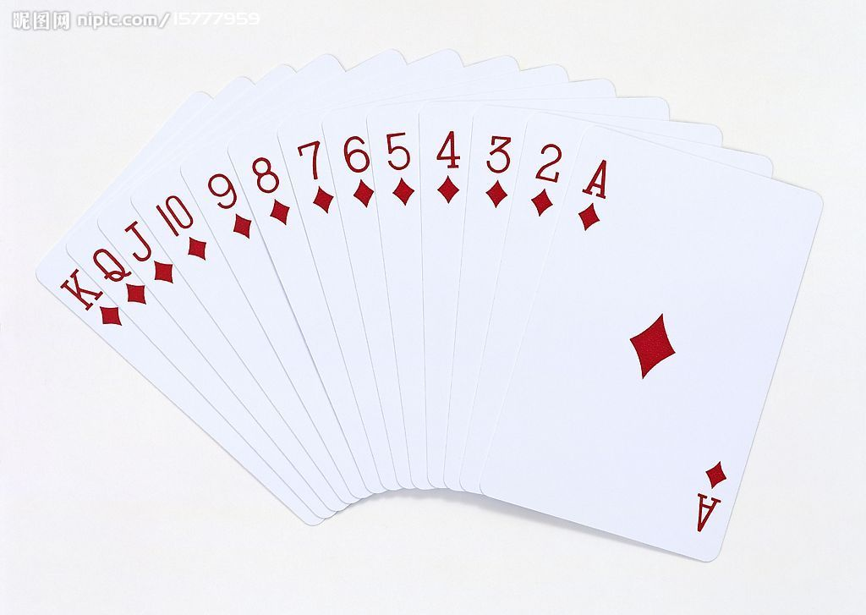
Approximation: concept
Competitiveness: example
  Problem: poker game
    you vs me
    range[1,13]
    I release the poker online
    u draw k times (e.g. n=10,k=3)
    Goal: gain as much as possible
  Alg
  Adversary

Slide 60

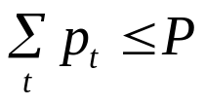
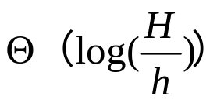



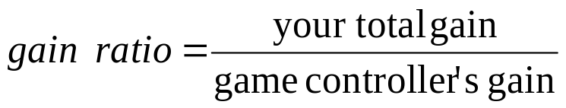
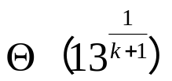
related paper
Network power allocation:
  Online sequence:
  Power budget:
  Time slot t: allocate
  Maximize:
  ALG: R=r^{k+1}; r^1 r^2 r^3 r^k

Slide 61
Approximation/competitive concepts
Problem from research:
online min active time for data center
  1 machine with state active/idle
  n tasks: each task j with
    Processing time p_j
    Release time r_i
    Deadline d_i
  Allocate the tasks with intersection
  Allocate when arrival
  Obj: min total active value
Q: what are the approximation/competitive algorithms
Q: bad example?
  open for you: how to make ‘fast’ offline/online decision

Slide 62
Mobile System, mechanism design and competitiveness
http://cse.seu.edu.cn/people/weiweiwu
weiweiwu@seu.edu.cn
Notes:
Combinatorial Optimization in Action
Flying a plane, riding a bus, buying a writing pad, or making a
phone call: Can you imagine that combinatorial optimization has
something to do with these activities? This lecture will provide
answers and show how the techniques of discrete mathematics
influence our daily life.
Combinatorial optimization in action
Combinatorial optimization exploded on the mathematical and scientific scene in the 1950s. In this lecture I will briefly survey its development for a wide audience. Theoretical design and analysis of algorithms dominated the early development of the field, while computational progress has been particularly significant in the last twenty years. These theoretical and computational achievements, combined with successful modeling of applications, have made it possible today to solve real-world problems of breathtaking size and diversity. The majority of the lecture will report on success stories in areas such as telecommunication, transportation, traffic and logistics. These results are based on ongoing cooperation between industry, the DFG Research Center MATHEON and my research group at Konrad-Zuse-Zentrum (ZIB).

Slide 63
Recap: big O, Ω
T(n)= O(f(n))：
  If there exists c > 0 & integer n_0≥1，such that T(n)≤c*f(n) for any n≥n_0
  e.g. T(n)=3n^3+2n^2，… , ∴T(n)= O(n^3)
Ω
10^9/s，n=60
Complexity： n n^2 n^3 n^5 2^n 3^n
Time: 6*10-8s 3.6*10-6s 2.16*10-4s 0.013min 3.66century 1.3*1013century

Slide 64
Recap: big O, Ω
T(n)= O(f(n))：
  If exists c > 0 & integer n_0≥1，such that T(n)≤c*f(n) for any n≥n_0
  e.g. T(n)=3n3+2n2，… , ∴T(n)= O(n3)
Ω
10^9/s，n=60
complexity n n^2 n^3 n^5 2^n 3^n
Time: 6*10-8s 3.6*10-6s 2.16*10-4s 0.013min 3.66century 1.3*1013century
Insertion sort
Binary sort

Slide 65
Why poly(n) important
E.g. 10^9/s，n=60
complexity n n^2 n^3 n^5 2^n 3^n
Time: 6*10-8s 3.6*10-6s 2.16*10-4s 0.013min 3.66century 1.3*1013century

Slide 66
Possible solving directions
If the problem is poly(n) computable
  Find polynomial time algorithms
  Reduce the time complexity : O(n^2)→O(n^logn)
  Find approximate solution with even faster algorithm
If the problem is difficult
  Prove the problem is NP-hard (mostly)
  Find polynomial time approximation algorithms
    tradeoff the gain with time
  Improve approximation ratio
  Find PTAS → (1+ε) – approximation (weak poly)
  Find FPTAS → (1+ε) – approximation (strong poly)
Prove the hardness of approximation

Slide 67
Network power allocation:
  Online sequence:
  Power budget:
  Time slot t: allocate
  Maximize:
Toy example: Porker game: you vs. game controller
  value range [1-13]
  each time 1 card is released (by game controller)
  n cards will be released one by one (eg. n=10, k=2)
  choose k cards at most
  maximize
Thank you

